Slide 1
TensorFlow 2.0

Slide 2
Outline
What is TensorFlow?
What is a Tensor?
Building a model using TensorFlow

Slide 3


TensorFlow
TensorFlow 2.0 is a library that provides a comprehensive ecosystem of tools for developers, researchers, and organizations who want to build scalable Machine Learning and Deep Learning applications.

Slide 4
TensorFlow
TensorFlow is a popular open-source library released in 2015 by the Google Brain team for building machine learning and deep learning models.

Slide 5
TensorFlow
It is based on Python programming language and performs numerical computations using data flow graphs to build models.

Slide 6
What is a Tensor?
TensorFlow is derived from its core component known as a tensor.
In TensorFlow, tensors are the basic building blocks used to represent data. A tensor can be thought of as a multi-dimensional array, similar to a matrix but with an arbitrary number of dimensions.

Slide 7
What is a Tensor?
Tensors can hold various data types, including integers, floating-point numbers, and strings.

Slide 8
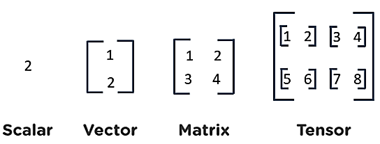
What is a Tensor?

Slide 9
How to build a model using TensorFlow

Slide 10
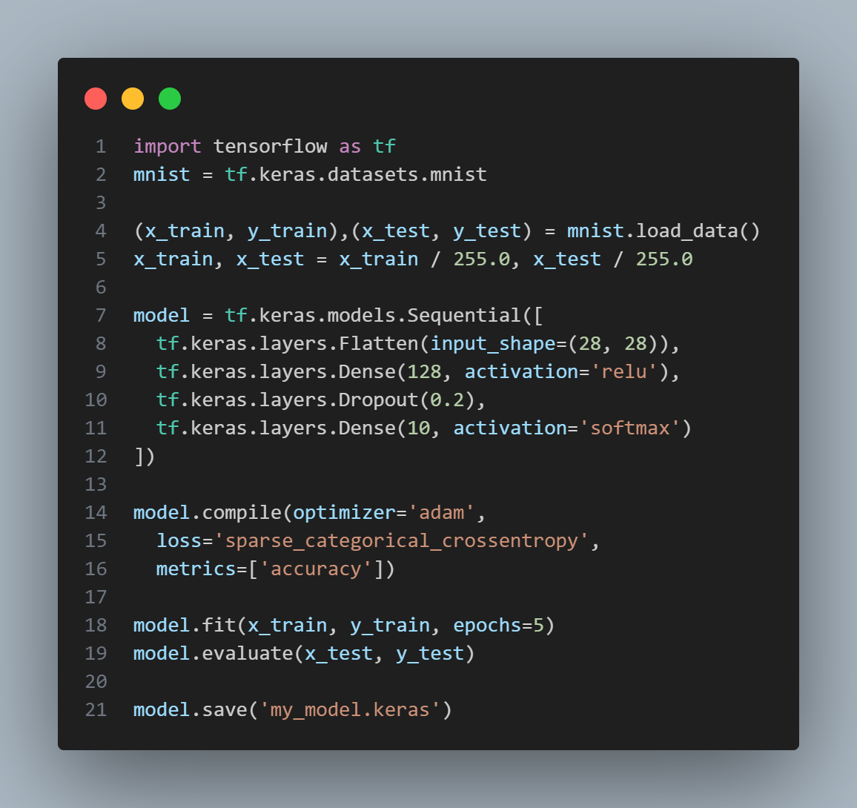
1. To use the tensorflow library, we use import tensorflow
Similar to scikit-learn, we can use a built-in dataset from the tf.keras API

Slide 11
2. We can load the built in dataset
using .load_data()

Slide 12
3. We can build a neural network and defining its layers
using .Sequential()

Slide 13
4. We can define the optimizer, loss function and metrics of the neural network using .compile()

Slide 14
5. We can train the neural network using .fit()and evaluate it using .evaluate()

Slide 15
6. We can save our trained model using .save()

Slide 16
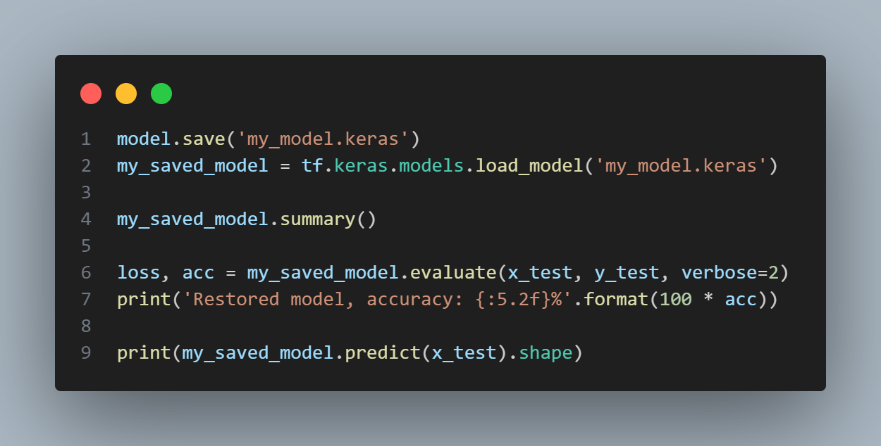
7. We can load any saved model using .load_model()

Slide 17
8. We can evaluate the loaded model and use it to predict an output by using .predict()

